Slide 1
Lecture 2: Introduction to Digital Modulation

Slide 2
Introduction to Digital Modulation
Digital modulation
  Is the transmission of digital modulated analog signals between two or more points in a communications system.
  Can be propagated through Earth’s atmosphere and used in wireless communication system - digital radio.
  Offer several outstanding advantages over traditional analog system.
    Ease of processing
    Ease of multiplexing
    Noise immunity

Slide 3
Applications:
    Low speed voice band data comm. modems
    High speed data transmission systems
    Digital microwave & satellite comm. systems
    PCS (personal communication systems) telephone

Slide 4
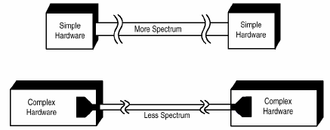
Why digital modulation?
The modulation of digital signals with analogue carriers allows an improvement in signal to noise ratio as compared to analogue modulating schemes.

Slide 5
PULSE MODULATION

Slide 6
Introduction to Pulse Modulation
Information signal is being transmitted in pulses
Some parameter of a pulse train is varied in accordance with the message signal
Pulse modulation includes many different methods of converting information into pulse form for transferring pulses from a source to a destination.
Divided into two categories;
1. Analog Pulse Modulation (APM)
2. Digital Pulse Modulation (DPM)

Slide 7
PULSE MODULATION
Some parameter of a pulse train is varied in accordance with the message signal
Analog Pulse Modulation – A periodic pulse train is used as a career wave, and some characteristic feature of each pulse (e.g. Amplitude, Duration or Position) is varied in a continuous manner in accordance with the corresponding sample value of the message signal. Basically, information is transmitted in analog form, but the transmission takes place at discrete times
Digital Pulse Modulation - The message signal is represented in a form that is discrete in both time and amplitude, thereby permitting its translation in digital form as a sequence of coded pulses

Slide 8


PULSE MODULATION
It involves sampling, quantization and encoding
Converting samples into discrete pulses
Transport the pulses over physical transmission medium.
Four (4) Methods
1. PAM
2. PWM
3. PPM
4. PCM
Analog Pulse Modulation
Digital Pulse Modulation

Slide 9
PULSE MODULATION :Sampling
What is sampling?
Sampling is the process of taking periodic sample of the waveform to be transmitted.
“the more samples that are taken, the more final outcome looks like the original wave.
However if fewer samples are taken, then other kinds information could be transmitted.”

Slide 10
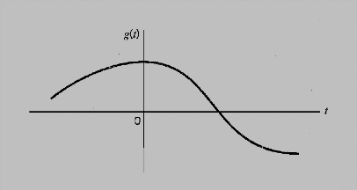
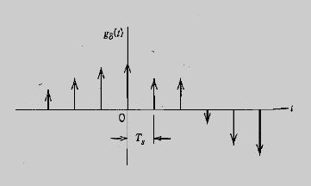
SAMPLING Ctd…
Analog Signal
Instantaneously sampled version
of analog signal
This signal is sampled instantaneously and at a uniform
Rate, once every T_{s} Seconds.
T_{s} = Sampling Period
f_{s} = 1/T_{s} = Sampling Rate
This process of uniformly sampling a continuous-time signal of finite energy
results in a periodic spectrum with a Period equal to the sampling rate.

Slide 11
Sampling Theorem
Sampling theorem (Nyquist’s theorem)
- is used to determine minimum sampling rate for any signal so that the signal will be correctly restored at the receiver.
Nyquist’s theorem states that,
“The original information signal can be reconstructed at the receiver with minimal distortion if the sampling rate in the pulse modulation system is equal to or greater than twice the maximum information signal frequency”

Slide 12
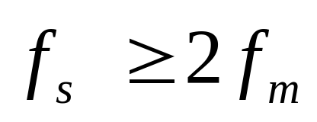
sampling frequency
_{fs=sampling frequency and}
fm(max) = maximun frequency of the modulating signal.

Slide 13
Condition of sampling process
1) sampling at Fs =2fm(max)
fs 2fs
figure 2.1 :
Frequency spectrum of modulating signal when sampled at fs=2fm(max)
V( Volts)

Slide 14
When the modulating is sampled at a minimum sampling frequency, the frequency spectrum is as shown in figure 2.1.
In practice it is difficult to design a low pass filter, in order to restore the original modulating signal

Slide 15
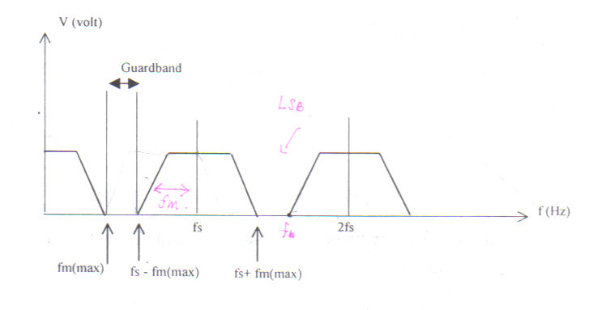
2) Sampling at fs> 2fm(max)
This sampling rate creates a guard band between fm(max) and the lowest frequency component (fs-fm(max)) of the sampling harmonics.
Therefore a more practical LPF can be used to restore the modulating signal.
Figure 2.2 Sampling at fs> 2fm(max)

Slide 16
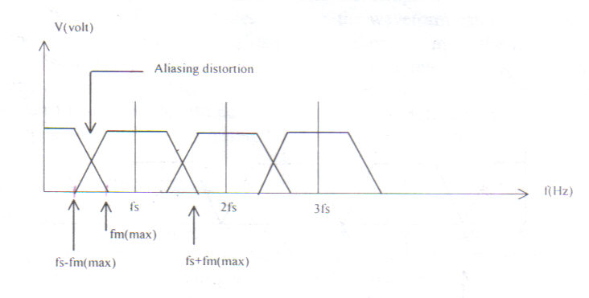
3) Sampling at fs < 2fm(max)
When the sampling rate is less than the minimum value, distortion will occurs. This distortion is called aliasing.
Figure 2.3 Sampling at fs < 2fm(max)

Slide 17
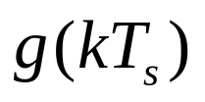

Aliasing is a phenomenon of a high frequency component in the spectrum of the signal seemingly to take in the identity of a lower frequency in the spectrum of its sampled version
Aliasing effect can be eliminated by using an anti-aliasing filter prior to sampling and using a sampling rate slightly higher than Nyquist rate (fs=2W).
Anti-aliasing
Filter
Sampler

Slide 18
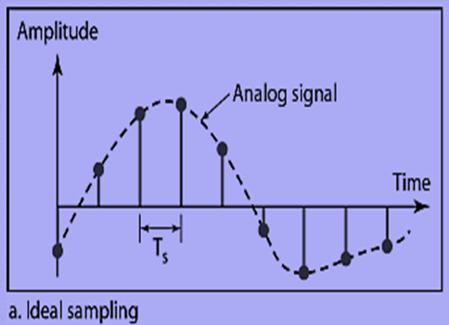
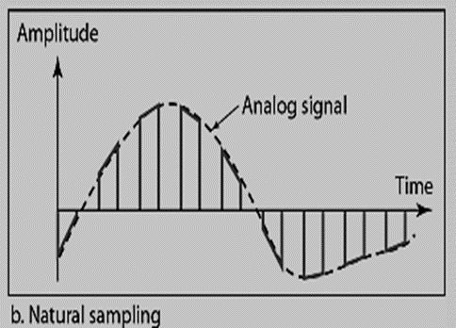
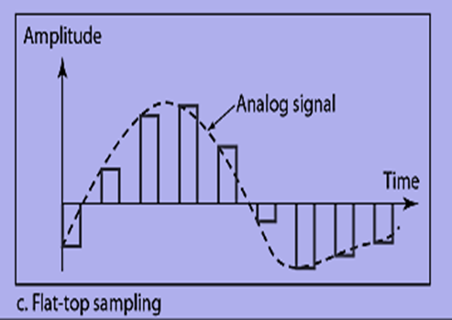
Types of sampling methods
There are three sampling methods.
Ideal Sampling
An Impulse is taken at each sampling Instant
Flat-top Sampling
Sample and hold like natural sampling but with single Amplitude value.
Natural Sampling
A pulse of short width with varying Amplitude

Slide 19
ANALOG PULSE MODULATION (APM)
In APM, the carrier signal is in the form of pulse waveform, and the modulated signal is where one of the characteristic (either amplitude, width or position) is changed according to the modulating/audio signal
The three common techniques of APM are: Pulse Amplitude Modulation (PAM),
Pulse Width Modulation (PWM) and
Pulse Position Modulation (PPM).

Slide 20
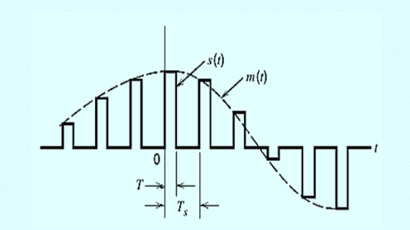
Pulse Amplitude Modulation (PAM)
The simplest form of pulse modulation
The amplitude of a constant width, constant position pulse (carrier signal) is varied according to the amplitude of the modulating signal.
Basically the modulating signal is sampled by the digital train of pulses and the process is based upon the sampling theorem

Slide 21
PAM Ctd…
The carrier is in the form of narrow pulses having frequency fs. The uniform sampling takes place in multiplier to generate PAM signal. Samples are placed Ts sec away from each other.
Multiplier
Modulating Signal
(Message Signal)
PAM
Signal
Pulses at sampling
Frequency

Slide 22
PAM Ctd…
Depending upon the shape and polarity of the sampled pulses, PAM is of two types
Natural PAM
Flat-topped PAM

Slide 23
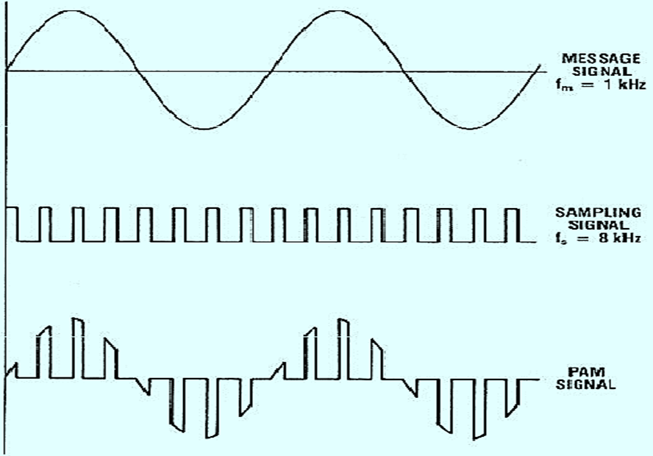
PAM Ctd…
Natural PAM
sampling occurs when top portion of the pulses are subjected
to Follow the modulating signal

Slide 24
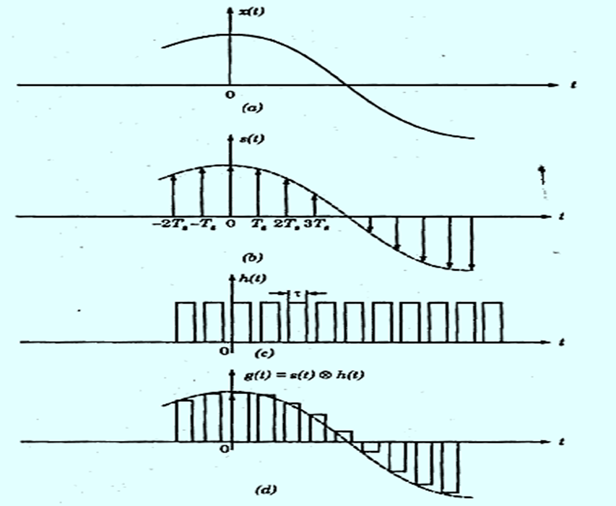
PAM Ctd…
Flat-Topped PAM
pulses have flat tops after modulation.

Slide 25
Pulse Width Modulation (PWM)
The technique of varying the width of the constant amplitude pulse proportional to the amplitude of the modulation signal.
Also known as Pulse Duration Modulation (FDM).
Either the leading edge, trailing edge or both may be varied by the modulating signal.

Slide 26
Pulse Width Modulation (PWM)
PWM gives better signal to noise performance than PAM.
PWM has advantage, when compared with PPM, that is its pulse are of varying width and therefore of varying power content. PWM still works if synchronization between transmitter and receiver fails, whereas PPM does not.

Slide 27
PWM Ctd…
Analog Signal
Width Modulated Pulses

Slide 28
Pulse Position Modulation (PPM)
PPM is when the position of a constant-width and constant-amplitude pulse within prescribed time slot is varied according to the amplitude of the modulating signal.
PPM has the advantage of requiring constant transmitter power output, but the disavantage of depending on transmitter-receiver synchronization.
PPM has less noise due to amplitude changes, becaused the received pulses may be clipped at the receiver, thus removing amplitudeschanges caused by noise.

Slide 29
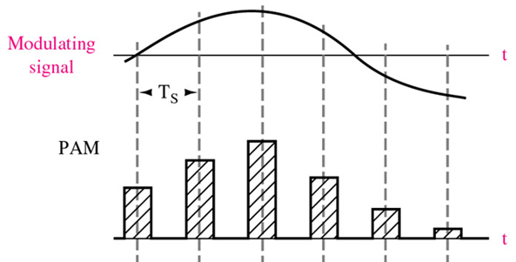
Pulse Amplitude Modulation (PAM)
Modulation in which the amplitude of pulses is varied in accordance with the modulating signal

Slide 30
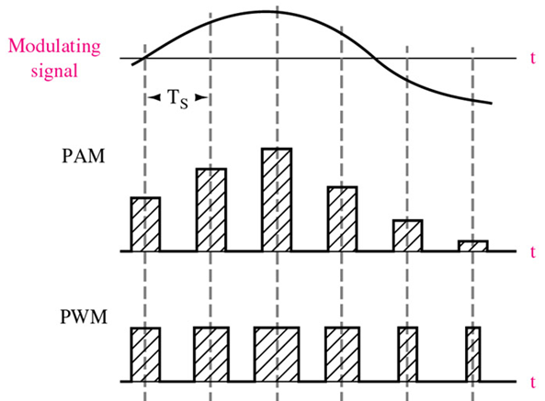
Pulse Width Modulation (PWM)
Modulation in which the duration of pulses is varied in accordance with the modulating signal

Slide 31
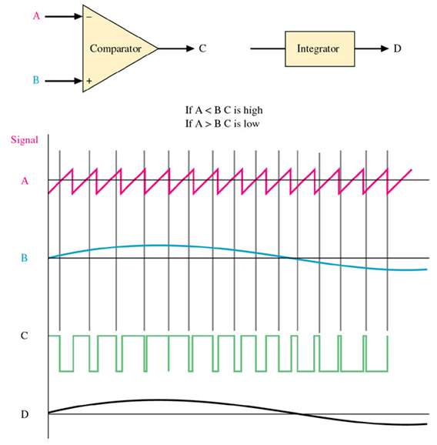
Pulse Width Modulation (PWM)

Slide 32
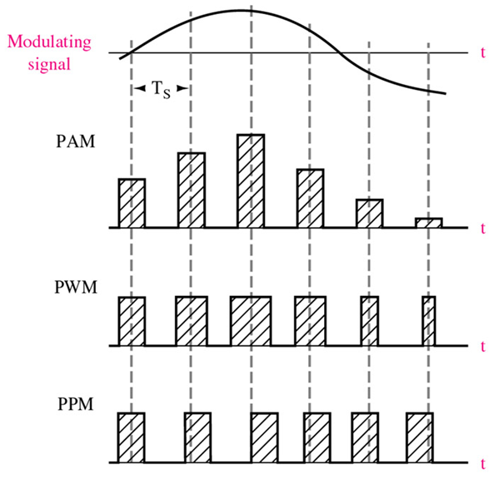
Pulse Position Modulation (PPM)
Modulation in which the temporal positions of the pulses are varied in accordance with some characteristic of the modulating signal.

Slide 33
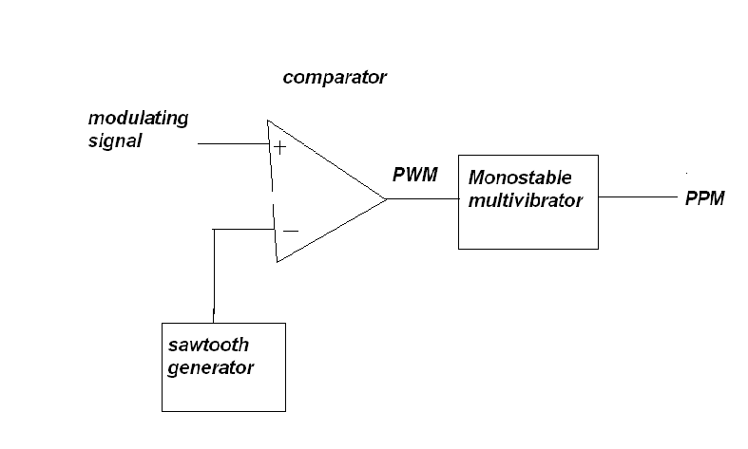
PWM, PPM GENERATION

Slide 34
PWM, PPM GENERATION Ctd…
The PPM signal can be generated from PWM signal.
The PWM pulses obtained at the comparator output are applied to a monostable multivibrator which is –ve edge triggered.
Hence for each trailing edge of PWM signal, the monostable output goes high. It remains high for a fixed time decided by its own RC components

Slide 35
PAM, PWM and PPM
Analog Signal
Amplitude Modulated Pulses
Width Modulated Pulses
Position Modulated Pulses

Slide 36
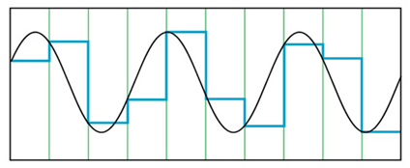
How to encode analog waveforms ?
(from analog sources into baseband digital signals)

Slide 37
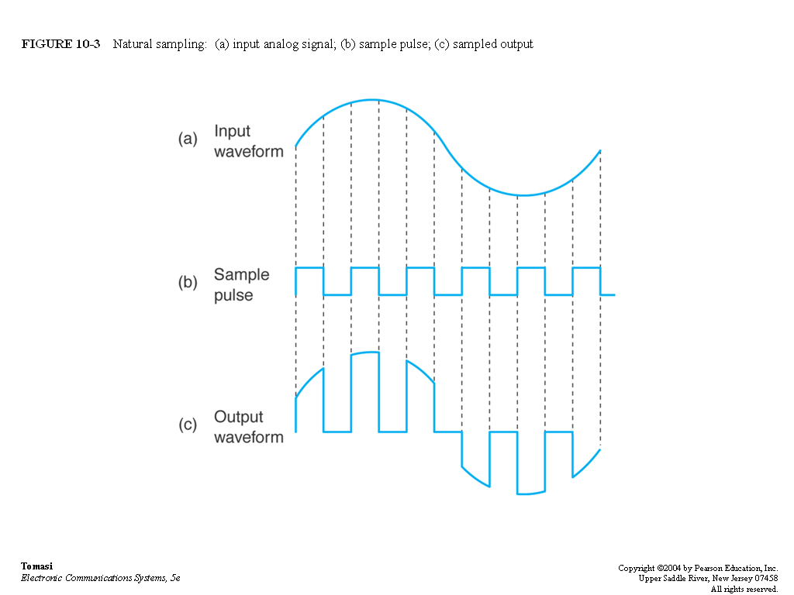
Natural Sampling

Slide 38
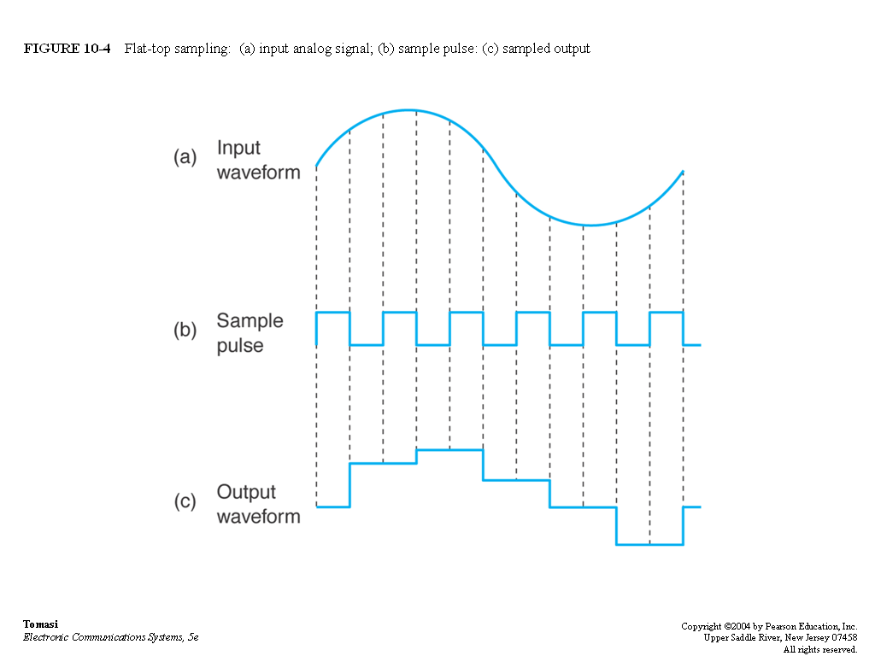
Flat-top Sampling

Slide 39
DIGITAL PULSE MODULATION (DPM)
Pulse Code Modulation ( PCM )
PCM is a form of digital modulation where group of coded pulses are used to represent the analog signal. The analog signal is sampled and converted to a fixed length, serial binary number for transmission.
A block diagram of a PCM system is as shown in figure 2.4

Slide 40
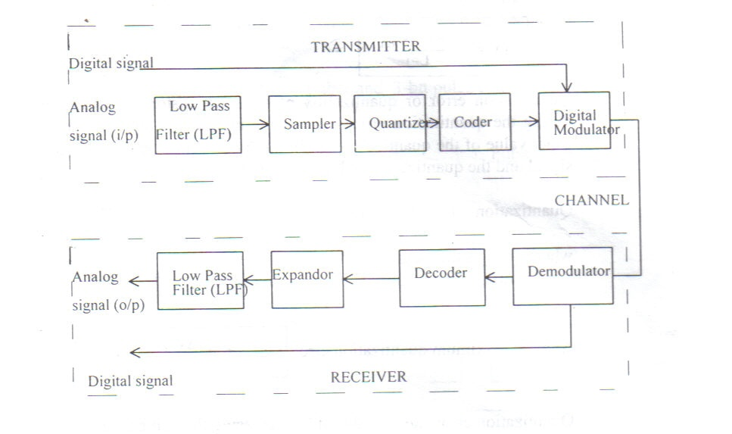
Fig.2.4 A block diagram of PCM system (single channel)

Slide 41
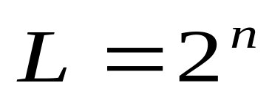
Principles of PCM
Three main process in PCM transmission are sampling, quantization and coding.
1. Sampling – is a process of taking samples of information signal at a rate of Nyquist’s sampling frequency.
2. Quantization – is a process of assigning the analog signal samples to a pre- determined discrete levels. The number of quantization levels ,L, depends on the number of bits per sample, n, used to code the signal. Where

Slide 42

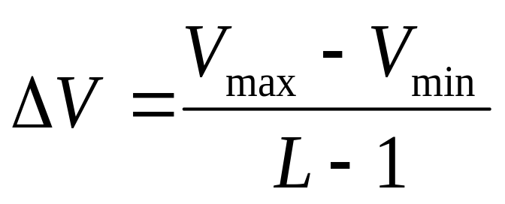
Principles of PCM (…cont.)
The magnitude of the minimum stepsize of the quantization levels is called resolution,
It is equal in magnitude to the voltage of the least significant bit of the magnitude stepsize of the digital to analog converter (DAC). The resolution depends on the maximum voltage, Vmax, and the minimum voltage Vmin of the information signal, where

Slide 43
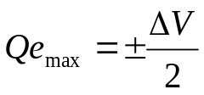
Principles of PCM (…cont.)
Quantization error or quantization noise is the distortion introduced during the quantization process when the modulating signal is not an exact value of the quantized level. It is the difference between original signal and the quantized signal magnitude that is :
Quantization error, Qe = |x(t)| - |q(t)|
Where |x(t)| is the magnitude of original signal
Where |q(t)| is the magnitude of quantized signal
The maximum quantization error,
Quantization error can be reduced by increasing the number of quantization level BUT this will increase the bandwidth required.

Slide 44
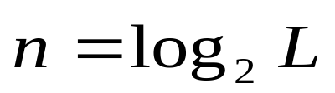
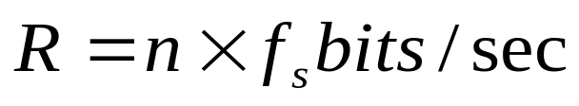

Principles of PCM (…cont.)
ENCODING
This is a process where each quantized sample is digitally encoded into n-bits codeword, where
n = number of bits/sample
L = number of quantization levels
Transmission bit rate (R) is the rate of information transmission (bits/sec).
It depends on the sampling frequency and the number of bit per sample used to encode the signal and is given by
Transmission bit rate
Transmission Bandwidth ;

Slide 45

Two digital signals: one with two signal levels and
the other with four signal levels
Notes:
Mbeya University of Science and Technology

Slide 46
Examples
A digital signal has 8 levels. How many bits are needed per level?
We calculate the number of bits from the formula
Each signal level is represented by 3 bits.
A digital signal has 9 levels. How many bits are needed per level?
Each signal level is represented by 3.17 bits.
The number of bits sent per level needs to be an integer as well as a power of 2.
Hence, 4 bits can represent one level.
Notes:
Mbeya University of Science and Technology

Slide 47
Analog pulse vs Digital pulse modulation
Analog pulse modulation
A periodic pulse train is used as the carrier wave
Some characteristic feature of each pulse is varied in a continuous manner in accordance with the corresponding sample value of the message signal
Analog pulse-modulation systems rely on the sampling process to maintain continuous amplitude representation of the message signal
Digital pulse modulation
The message signal is represented in a form that is discrete in both time and amplitude
Its transmission in digital form as a sequence of coded pulse
Digital pulse-modulation system use not only the sampling process but also the quantization process.
Digital modulation makes it possible to exploit the full power of digital signal-processing techniques.

Slide 48
Examples
2.1 A sinusoidal input wave of 3kHz is to be sampled at the lowest rate for transmission as pulses. Calculate the minimum sampling frequency required, so that all components of the wave can be reconstructed at the receiver.
2.2 The PCM sampled are encoded into 4-bits system. If the minimum sampling rate used is 8kHz, calculate
the frequency of the information signal
the quantization level.
the transmission rate
The transmission bandwidth

Slide 49
Thank You

